Slide 1

Welcome!
Notes:
Hello dear vertos! Welcome to Lovely Professional University. I am your trainer, Garima Rachel Lyall and I welcome you to the first session of PES 318 Soft Skills.

Slide 2

Notes:
Congratulations on your choice of Computer Applications course. This course is specially designed to give you a deep insight into the world of technology and what is corporate, their expectations from you and how you can enhance your core skills with the help of soft skills.

Slide 3
What are Soft-skills?
Soft skills are character traits and interpersonal skills that characterize a person's relationships with other people. In the workplace, soft skills are considered to be a complement to hard skills, which refer to a person's knowledge and occupational skills.

Slide 4

Soft Skills – PES 318
The upcoming journey
Notes:
Hence, after a lot of thought, focused research and industry feedback we at Lovely Professional University decided to give our vertos an edge over their competition globally by training them and giving them a chance to hone their soft skills with proper mentoring and handholding via the course added in your degree. The Course code for this is PES 318 and the course title is Soft Skills.

Slide 5
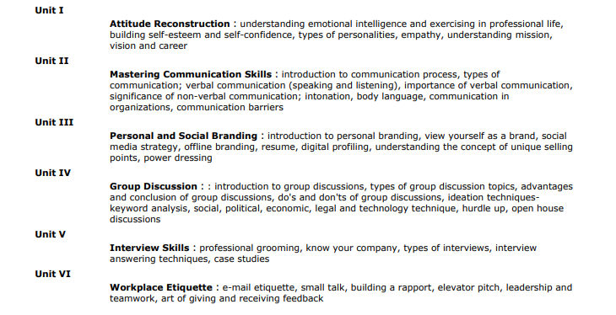
Soft Skills – PES 318
The upcoming journey
Notes:
The entire course would include a total of 6 modules focusing on various skills for the development of an industry ready professional.

Slide 6
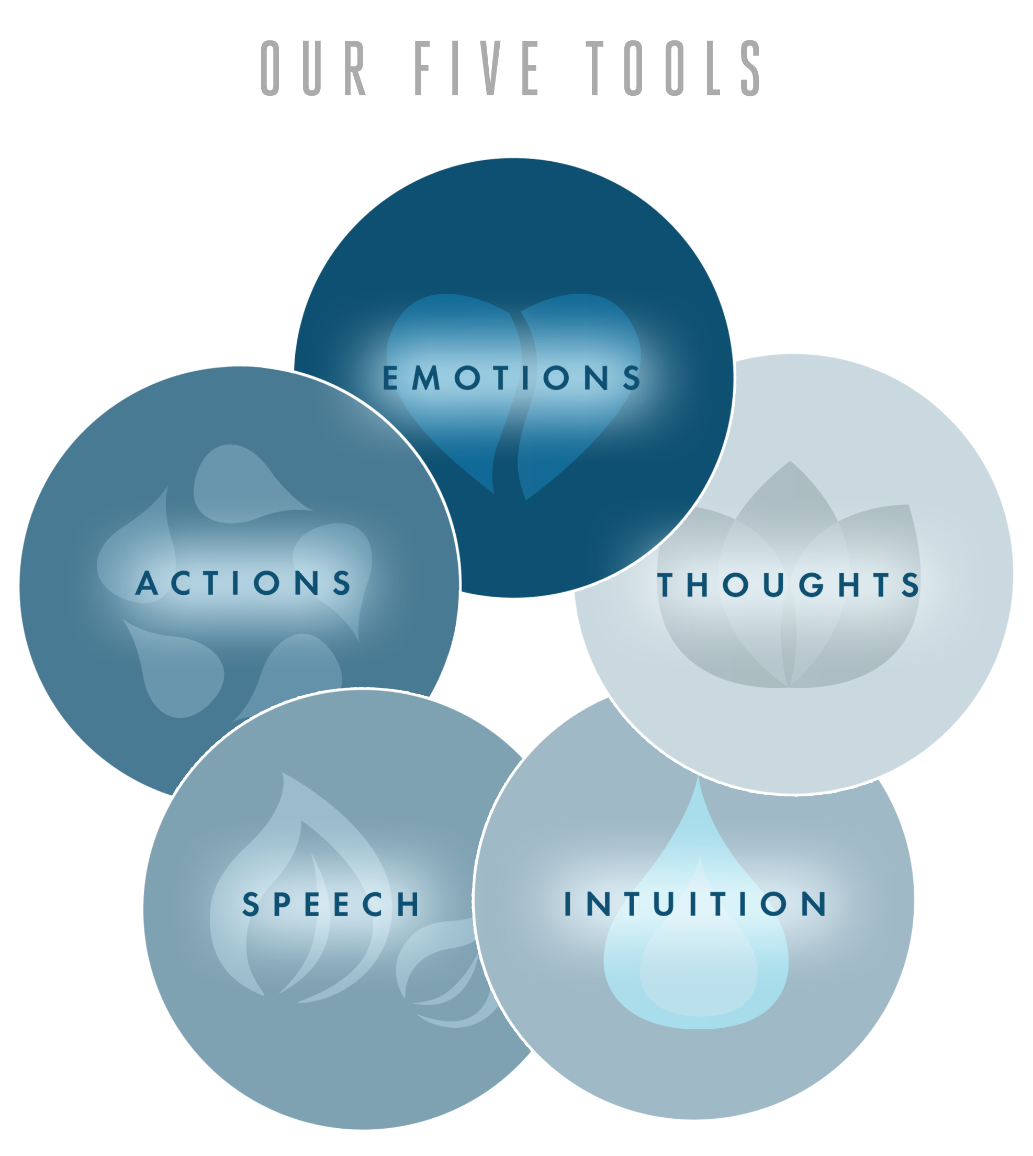
Unit I: Attitude Reconstruction
Notes:
This entire course is a hands on learning course where we go beyond theories and practically work on honing the skills that we already have in us and inculcating new skills under the expert guidance of our mentors. Starting with Unit 1: attitude reconstruction that will help the student understand what changes do they need to make in their attitude and behavior. How they need to reconstruct their thoughts and control the outcomes of their actions by managing the 5 most important aspect of the attitude- Emotions, thoughts, intuition, speech and actions. Once the vertos have understood the attitude they need to become a successful professional in their field, we take then next step of improving the way of showcasing our attitude- “the communication skills.” Communication is not only about speaking but a lot beyond that, it is an important part of many skills like teamwork, negotiations, business writing, influencing and presentations as well!

Slide 7
What you all will learn in this:-
Understanding Emotional Intelligence and exercising in professional life
Building self- esteem and self-confidence
Types of personality
Empathy
Understanding mission, vision and career
Notes:
In this you all will get the proper idea on all these 5 sub-topics and their importance in your professional and personal life.

Slide 8
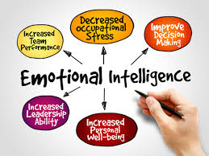
Understanding Emotional Intelligence and exercising in professional life
Notes:
Emotional intelligence is the capacity to understand and manage your emotions. The skills involved in emotional intelligence are self-awareness, self-regulation, motivation, empathy, and social skills.

Slide 9
What you will learn in understanding emotional intelligence and exercising in professional life:-
What is attitude
What is emotional intelligence
Importance of emotional intelligence in personal and professional life.
Exercises of emotional intelligence in personal and professional life.
Tips to enhance emotional intelligence.
Notes:
Here, you all will get the overview of attitude, its importance and what is EQ and how it helps to enhance your decision making, empathy, self-awareness, self-confidence and self esteem.

Slide 10

Notes:
Thank you and see you soon!

